Slide 1
Deep Causal Learning: Representation, Discovery and Inference
ZIZHEN DENG, XIAOLONG ZHENG*, HU TIAN, and DANIEL DAJUN ZENG,

Slide 2
What is causal learning ?
Learning the cause–effect relationships or determining the causal status among a set of two or more events

Slide 3
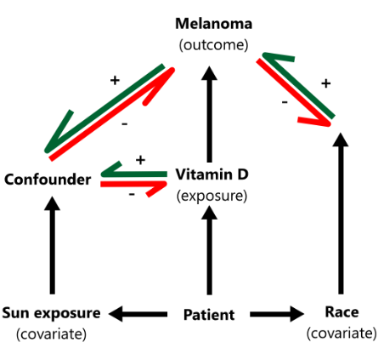
Introduction
Variable:
Treatment
Outcome
Covariate: may or maynot be related to the outcome.
Confounder: related to both the outcome and treatment.
Example:
Target: Vitamin D supplements prevent melanoma.
Treatment: Vitamin D
Outcome: Melanoma
Covariate: race, sun exposure
https://www.straighthealthcare.com/confounder-covariate.html
Notes:
Sun 影響 D:
會吃維他命D的人，有可能是因為有健康意識所以也會避免照太陽
有可能因為不想曬黑所以不照太陽但是需要吃維他命D
醫生建議患者吃維他命D

Slide 4
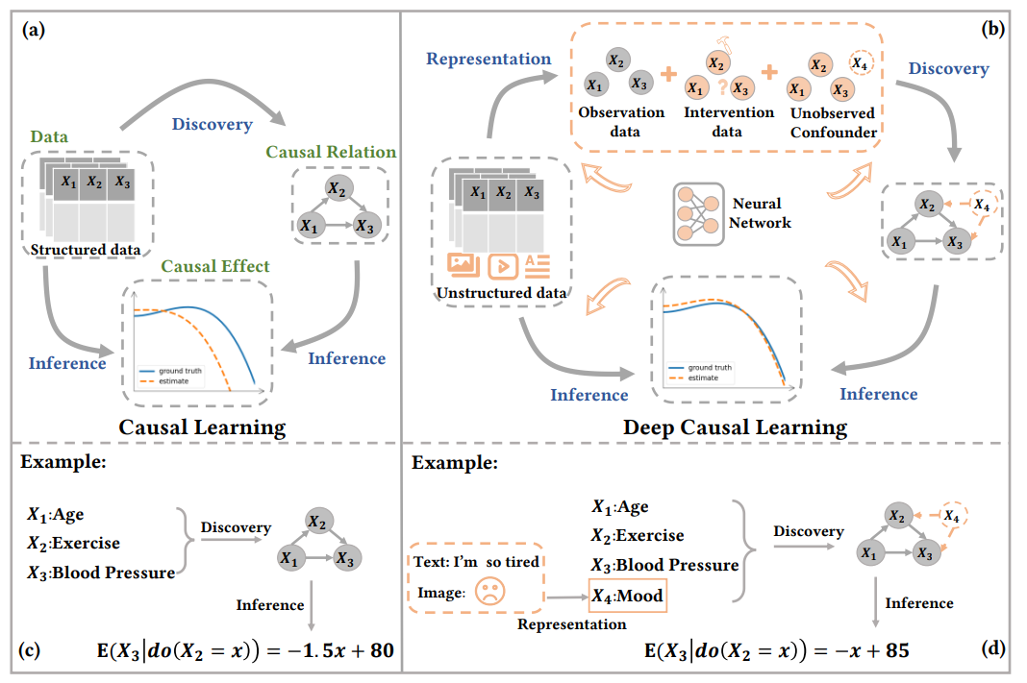
causal learning vs deep causal learning

Slide 5
Data
T
Y
Observational data:
Collect data of a group of individuals over a period of time
Find the relationship in each variable.
Intervention data:
Use interest variable (caffeine intake) to randomly assign(reduce confounding variable bias) individuals to the intervention or control group.
Any differences in sleep quality between the intervention and control groups can be attributed to the effect of caffeine intake rather than other confounding variables
Counterfactual data:
Data that describes what would have happened to an individual under different conditions
Vitamin D
Melanoma
Notes:
SCM: SCM 是一個用於理解因果關係的框架，它強調生成觀察數據的機制。 它指定了一組方程式，這些方程式描述了系統中的不同變量如何相互作用以產生觀察到的數據。 SCM 框架使用有向無環圖 (DAG) 來直觀地表示變量之間的因果關係。
Data
Observational data:
The observation data could include variables such as:
The amount of caffeine consumed each day, 每天攝入的咖啡因量
The time of day that caffeine was consumed 攝入咖啡因的時間
The number of hours of sleep each night 每晚睡眠的小時數
The quality of sleep, as measured by a self-report scale or a sleep-tracking device 睡眠質量，通過自我報告量表或睡眠跟踪設備測量
我們以從 observation data 中了解 variable 的 relationship，像是 攝取太多 和 太晚攝取 都會影響睡眠
Intervention data
Confounding variables 例如，年齡、性別、生活習慣等因素都可能影響咖啡因攝入量和睡眠質量，因此很難確定兩者(T和Y)之間的因果關係。
將個體 隨機分配 製對照組和控制組 可以降 confounding bias 的風險。因此，對照組和控制組織間的差異就可以歸於因為 interest variable(caffeine income difference)的不同。
Counterfactual data:
個人對不同 interest variable 的差異
和 intervetion data 一樣都是為了降低 confounder 但是一個是用 group 一個是對個人。

Slide 6
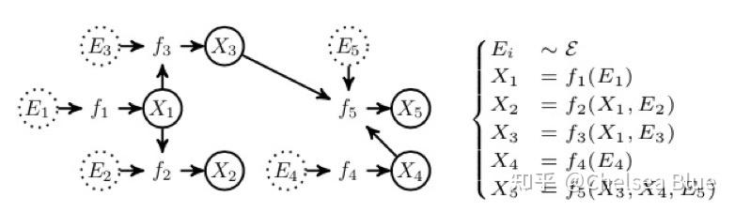

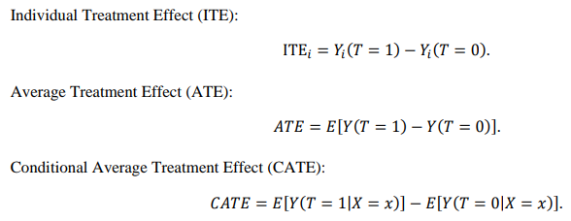
Two frameworks
Struction Causal models (SCM)
SCM: Emphasizes the mechanisms(F) that generate the observed data.
Causal Graph: each SCM model has a corresponding causal graph (DAG)
Average Treatment Effect (ATE):
Potential Outcome model (POM)
Focuses on comparing potential outcomes under different conditions or interventions.
Notes:
SCM: SCM 是一個用於理解因果關係的框架，它強調生成觀察數據的機制。 它指定了一組方程式，這些方程式描述了系統中的不同變量如何相互作用以產生觀察到的數據。 SCM 框架使用有向無環圖 (DAG) 來直觀地表示變量之間的因果關係。
Data
Observational data:
The observation data could include variables such as:
The amount of caffeine consumed each day, 每天攝入的咖啡因量
The time of day that caffeine was consumed 攝入咖啡因的時間
The number of hours of sleep each night 每晚睡眠的小時數
The quality of sleep, as measured by a self-report scale or a sleep-tracking device 睡眠質量，通過自我報告量表或睡眠跟踪設備測量
我們以從 observation data 中了解 variable 的 relationship，像是 攝取太多 和 太晚攝取 都會影響睡眠
Intervention data
Confounding variables 例如，年齡、性別、生活習慣等因素都可能影響咖啡因攝入量和睡眠質量，因此很難確定兩者(T和Y)之間的因果關係。
將個體 隨機分配 製對照組和控制組 可以降 confounding bias 的風險。因此，對照組和控制組織間的差異就可以歸於因為 interest variable(caffeine income difference)的不同。
Counterfactual data:
個人對不同 interest variable 的差異
和 intervetion data 一樣都是為了降低 confounder 但是一個是用 group 一個是對個人。

Slide 7
causal learning vs deep causal learning
Causal Learning
Causal Discovery
Using observational data to discover causal relationships between variables
Causal Inference
The causal effect is estimated.
Deep Causal Learning
Deep Causal Variable Representation
Learn the low-dimensional balanced structured representation of high-dimensional (ex:MP4)
Deep Causal Discovery
Deep Causal Inference
Notes:
POM: 側重於比較不同條件或乾預措施下的潛在結果。 它假設給定個體有多種潛在結果，並且觀察到的結果只是在特定條件或乾預下實現的這些潛在結果之一。 POM 框架使用 Y(0) 和 Y(1) 等符號來表示個體在不同條件或乾預下的潛在結果。
SCM vs POM:這兩個框架之間的一個主要區別是 SCM 強調生成數據的機制，而 POM 側重於比較不同條件或乾預措施下的潛在結果。 SCM框架常用於物理、工程等領域，而POM框架常用於醫學、社會科學等領域。兩個框架之間的另一個主要區別是它們處理反事實的方式。 SCM 使用反事實來解釋生成觀察到的數據的機制，而 POM 使用反事實來比較不同條件或乾預下的潛在結果。

Slide 8
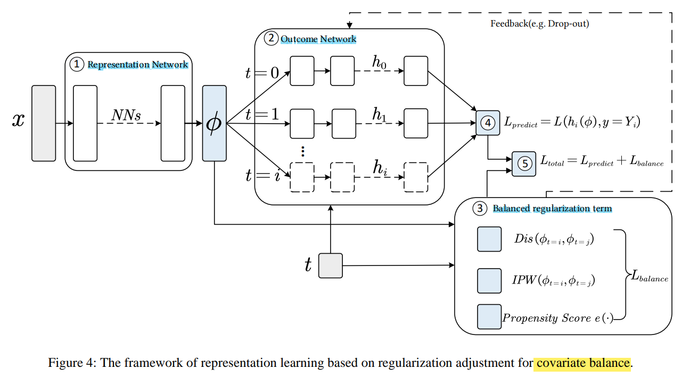
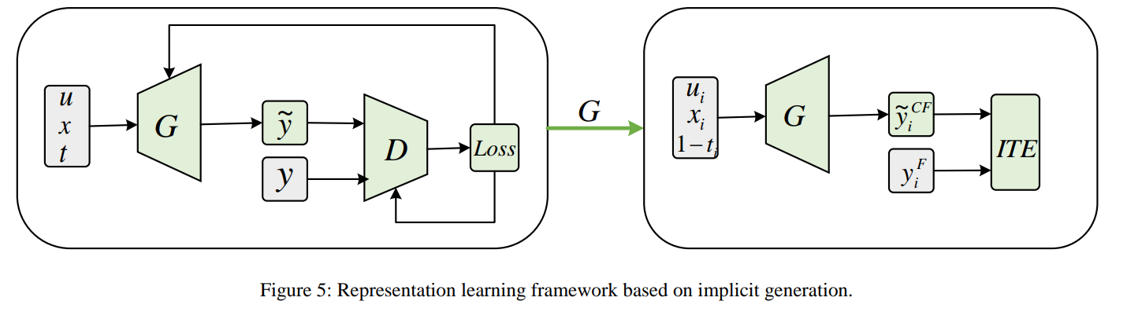
Deep Causal Representation
Two fundamental problems of causal inference: (1 )selection bias (2) lack of counterfactual data
Causal variable representation target:
covariates are balanced
counterfactual data or the causal generation mechanism of the variable can be obtained.
Regularization Adjustment for Covariate Balance
Implicit Generation of Counterfactual Data (GAN)
Explicit Generation for Disentangled Causal Mechanisms

Slide 9
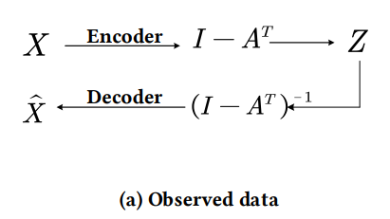
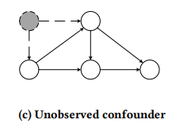
Deep causal discovery
Observation Data-driven Causal Discovery
Non-time series data: the methods usually convert the constraints of acyclicity into constraints on the trace of the adjacency matrix
Time series data: the causal graph obtained from the time series is likely to have cycles, which does not satisfy the DAG condition
Intervention Data-driven Causal Discovery
Known Intervention
Unknown Intervention
Unobserved Confounders Data-driven Causal Discovery
Non-time series data: More efficiently and accurately find causal relationships in the presence of unobserved confounders.
Time series data:
Notes:
將DAG 圖中 非循環約束( constraints of acyclicity) 轉化為對鄰接矩陣積( trace of the adjacency matrix)的約束

Slide 10
End

Slide 11
0
Abstract
Notes:
covariates are pre-selected variables that are included in the analysis to control for potential confounding factors, while
confounders are variables that are associated with both the treatment and the outcome and need to be controlled for to accurately estimate the causal effect.

Slide 12
causal learning vs deep causal learning
Causal Learning
Causal Discovery
Using observational data to discover causal relationships between variables
Causal Inference
The causal effect is estimated.
Deep Causal Learning
Deep Causal Variable Representation
Learn the low-dimensional balanced structured representation of high-dimensional (ex:MP4)
Deep Causal Discovery
Deep Causal Inference
Notes:
POM: 側重於比較不同條件或乾預措施下的潛在結果。 它假設給定個體有多種潛在結果，並且觀察到的結果只是在特定條件或乾預下實現的這些潛在結果之一。 POM 框架使用 Y(0) 和 Y(1) 等符號來表示個體在不同條件或乾預下的潛在結果。
SCM vs POM:這兩個框架之間的一個主要區別是 SCM 強調生成數據的機制，而 POM 側重於比較不同條件或乾預措施下的潛在結果。 SCM框架常用於物理、工程等領域，而POM框架常用於醫學、社會科學等領域。兩個框架之間的另一個主要區別是它們處理反事實的方式。 SCM 使用反事實來解釋生成觀察到的數據的機制，而 POM 使用反事實來比較不同條件或乾預下的潛在結果。

Slide 13
causal learning vs deep causal learning

Slide 14
Introduction
Treatment: 新藥物
T
Y
Outcome: 心臟病風險高低
U
Covariate: 年紀
C
Confounder: 吸菸

Slide 15
Two frameworks
Struction Causal models
SCM: Emphasizes the mechanisms(F) that generate the observed data.
Causal Graph: each SCM model has a corresponding causal graph (DAG)
Data:
Observational data:
Collect data of a group of individuals over a period of time
Find the relationship in each variable.
Intervention data:
Use interest variable (caffeine intake) to randomly assign(reduce confounding variable bias) individuals to the intervention or control group.
Any differences in sleep quality between the intervention and control groups can be attributed to the effect of caffeine intake rather than other confounding variables
Counterfactual data:
Data that describes what would have happened to an individual under different conditions
Potential Outcome model (POM)
focuses on comparing potential outcomes under different conditions or interventions.
T
Y
Caffeine intake
Sleep quality
Notes:
SCM: SCM 是一個用於理解因果關係的框架，它強調生成觀察數據的機制。 它指定了一組方程式，這些方程式描述了系統中的不同變量如何相互作用以產生觀察到的數據。 SCM 框架使用有向無環圖 (DAG) 來直觀地表示變量之間的因果關係。
Data
Observational data:
The observation data could include variables such as:
The amount of caffeine consumed each day, 每天攝入的咖啡因量
The time of day that caffeine was consumed 攝入咖啡因的時間
The number of hours of sleep each night 每晚睡眠的小時數
The quality of sleep, as measured by a self-report scale or a sleep-tracking device 睡眠質量，通過自我報告量表或睡眠跟踪設備測量
我們以從 observation data 中了解 variable 的 relationship，像是 攝取太多 和 太晚攝取 都會影響睡眠
Intervention data
Confounding variables 例如，年齡、性別、生活習慣等因素都可能影響咖啡因攝入量和睡眠質量，因此很難確定兩者(T和Y)之間的因果關係。
將個體 隨機分配 製對照組和控制組 可以降 confounding bias 的風險。因此，對照組和控制組織間的差異就可以歸於因為 interest variable(caffeine income difference)的不同。
Counterfactual data:
個人對不同 interest variable 的差異
和 intervetion data 一樣都是為了降低 confounder 但是一個是用 group 一個是對個人。

Slide 16
Two frameworks
Struction Causal models
Average Treatment Effect (ATE):
Potential Outcome model (POM)
Notes:
SCM
治療對結果的平均因果效應，計算為接受治療和未接受治療的結果的預期值的差異。 這可以在數學上表示為 ATE=E[Y(1)]-E[Y(0)]
ATE 是使用隨機對照試驗、自然實驗或觀察研究等方法估算的，並對混雜變量進行了適當的統計調整。 與 POM 不同 SCM 不需要對變量之間因果關係的結構進行強假設，ATE 的估計是基於可觀察數據和因果推理技術。
POM
ATE 表示治療對結果的平均因果效應，對人口中的所有單位進行平均。 這可以在數學上表示為 POM=E[Y(1)-Y(0)]，其中 Y(1) 和 Y(0) 分別是治療和未治療的潛在結果，E 代表對 人口
ATE 是通過結合使用因果假設（例如治療對結果的因果效應）和統計方法（例如回歸分析或工具變量）來估計的。 POM 中 ATE 的估計通常需要對變量之間因果關係的結構進行強有力的假設，這在實踐中可能難以驗證。

Slide 17



Deep Causal Representation
Two fundamental problems of causal inference: (1)selection bias (2) lack of counterfactual data
Causal variable representation target:
covariates are balanced
counterfactual data or the causal generation mechanism of the variable can be obtained.
Regularization Adjustment for Covariate Balance
Adjusted through various forms of regularization and attempts to balance covariates as much as possible, while obtaining structured variable representations
(1) input : covariates
(2) input : reprs. of covariates output : potential outcome
(3) represents the difference in covariate distribution between the treatment and control groups
(4) record the error between and
(5)

Slide 18
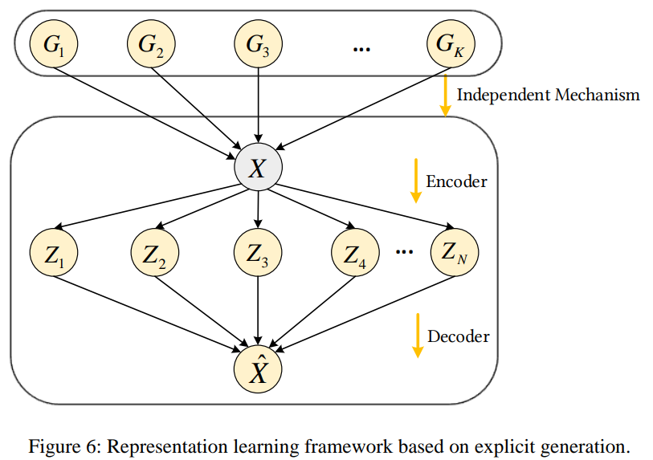
Deep Causal Representation
Implicit Generation of Counterfactual Data (GAN)
It eliminates selection bias and counterfactual data are generated directly because the discriminator is unable to distinguish the received sample from the treatment group（T = 1）or control group（T = 0）
Explicit Generation for Disentangled Causal Mechanisms
每個 表徵 variable 都被認為是一種 disentangled causal mechanism 以獲得更穩定的表徵
X is the observed variable
G is real mechanics generate factors
Z is the learned latent representation
Notes:
3-1 Confounder bias: 混淆偏差 = covariate
平衡協變量的目的是創造暴露和未暴露受試者的可交換性，從而消除與治療和結果相關的變量的混雜效應
3-2 選擇偏倚selection bias：由於Confounders的存在，treatment組合對照組的分佈有可能不一致，因此導致出現偏差，這也使得推理更加困難

Slide 19
Deep causal discovery
Observation Data
variables are measured but not directly manipulated
Intervention Data-driven
data that is obtained from experiments where the researcher actively intervenes on one or more variables in order to observe the effects on other variables
Unobserved Confounders Data
Unobserved confounders refer to variables that affect both the treatment and outcome variables in a study, but are not measured or observed.
Example: Caffeine intake and sleep quality
Observation data: surveying participants about their caffeine consumption and sleep habits, and then analyzing the correlations between these variables.
Intervention data: involve randomly assigning participants to either a group that receives caffeine or a group that receives a placebo, and then measuring their sleep quality
Unobserved confounders data: genetic factors that affect caffeine metabolism or sleep patterns could be potential unobserved confounders.
Notes:
例如
Observation data: 考慮一項檢查咖啡因攝入量與睡眠質量之間關係的研究。 觀察數據可能涉及調查參與者的咖啡因攝入量和睡眠習慣，然後分析這些變量之間的相關性。 然而，這種方法無法確定咖啡因的攝入是否直接導致睡眠質量的變化，或者是否有其他因素影響這兩個變量。
Intervention data:
可能涉及將參與者隨機分配到接受咖啡因的組或接受安慰劑的組，然後測量他們的睡眠質量。 通過積極干預咖啡因變量，研究人員可以控制其他混雜變量並建立咖啡因攝入量與睡眠質量之間的因果關係
通過積極干預咖啡因變量，研究人員可以控制其他混雜變量，並建立咖啡因攝入量與睡眠質量之間的因果關係。
Unobserved data: 影響咖啡因代謝或睡眠模式的遺傳因素可能是潛在的未觀察到的混雜因素。

Slide 20
Deep causal discovery
Observation Data-driven Causal Discovery
Non-time series data: the methods usually convert the constraints of acyclicity into constraints on the trace of the adjacency matrix
Time series data: the causal graph obtained from the time series is likely to have cycles, which does not satisfy the DAG condition
Intervention Data-driven Causal Discovery
Known Intervention
Unknown Intervention
Unobserved Confounders Data-driven Causal Discovery
Non-time series data: More efficiently and accurately find causal relationships in the presence of unobserved confounders.
Time series data:
Notes:
將DAG 圖中 非循環約束( constraints of acyclicity) 轉化為對鄰接矩陣積( trace of the adjacency matrix)的約束

Slide 21
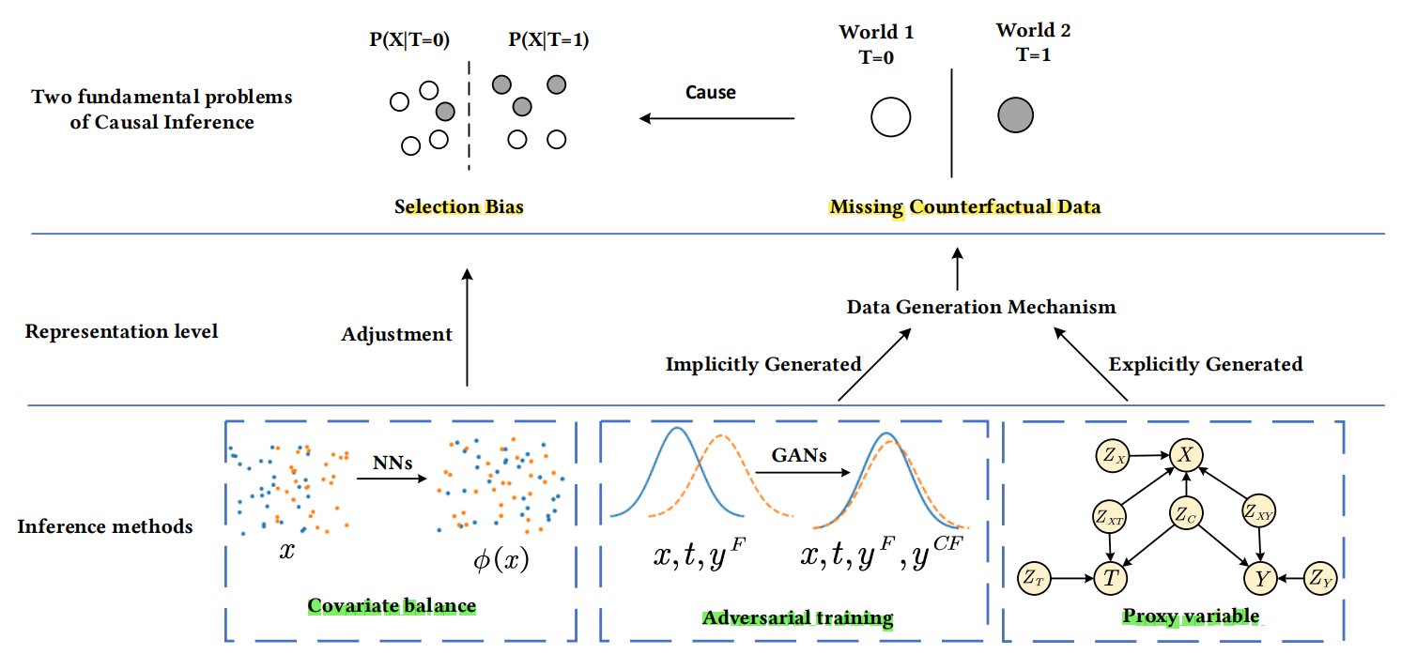
Deep causal inference
Core problem:
(1) missing counterfactual data
(2) selection bias
CI method method to solve problem:
selection bias-oriented
Counterfactual data-oriented methods
Deep CI method :
covariate balance-based methods (1) : 調整 covariates 以平衡不同 treatment groups 中covariates 的分佈，從而消除選擇偏差(selection bias-oriented)
adversarial training-based methods (2) : 利用對抗訓練使判別器無法區分真實數據和生成器生成的數據，從而實現隱式反事實數據的生成
proxy variable-based methods (3) : 將數據生成機制建模為多個潛在變量之間的聯合作用，以實現顯式反事實生成(study the presence of unobserved confounders)
deep structural causal model methods (4) : 通常將SCM和NN結合，利用SCM的結構信息和神NN的擬合能力對數據生成機制進行建模，實現反事實生成。

Slide 22
01
introduction

Slide 23
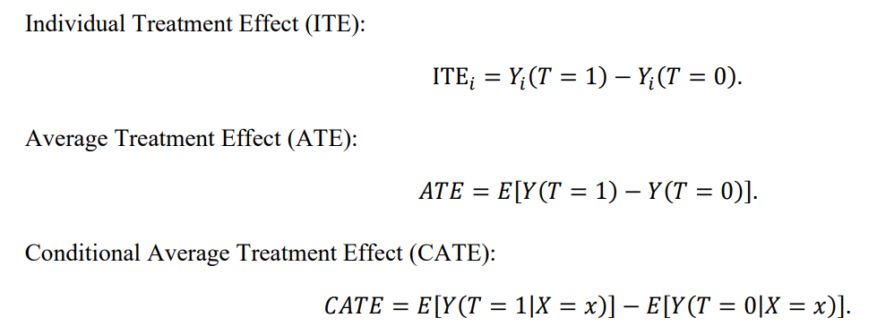
3. Deep causal inference
Structure Causal Model for evaluating causal effect:
The average treatment effect (ATE) under the SCM framework:
calculating the causal effect is to calculate the probability under the intervention
Potential Outcome Model for evaluating causal effect:

Slide 24
Introduction
Traditional CD method:
constraint-based method, score-based methods, asymmetric (function)-based methods
Traditional CI method:
whether the causal effect can be estimated based on the existing information is determined, and in causal estimation, specific causal effect values are obtained.
structural causal model (SCM) , potential outcome model (POM)
Traditional Problem:
low-dimensional structured data: Nowaday, many high-dimensional unstructured data need ex: video, image
Even if causal variables are structured, their covariate distributions could be unbalanced, becoming a source of selection bias. For causal discovery, most methods require strong assumptions For causal inference, due to the lack of counterfactual data, the gold standard for estimating causal effects is random controlled trials (RCT)
The key problem with causal inference from observational data is selection bias,which consists of confounding bias (from confounders) and data selection bias (from colliders).

Slide 25
Introduction
The three core strengths of deep learning for causal learning are strong representational capabilities, fitting capabilities, and the ability to approximate data generation mechanisms.
deep representation : (1) learn the low-dimensional balanced structured representation of high-dimensional, unstructured and unbalanced data so that variables can be better used for causal discovery and causal inference (2) universal approximation theorem indicates that neural networks can learn extremely complex functions to estimate heterogeneous treatment effects with low bias estimators.
causal discovery: it has become the main continuous optimization method to solve the long-standing combinatorial optimization problem and can theoretically cope with large-scale data.
causal generation: GAN(implicitly), VAE(explicitly)
Neural network-based methods for modeling data mechanisms require very little prior knowledge and do not make many assumptions about the relationship between variables, so that deep learning-based causal inference and causal discovery methods allow the presence of unobserved confounders and can also make use of intervention data.

Slide 26
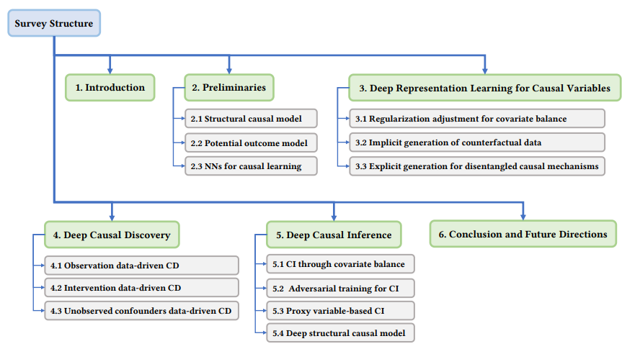
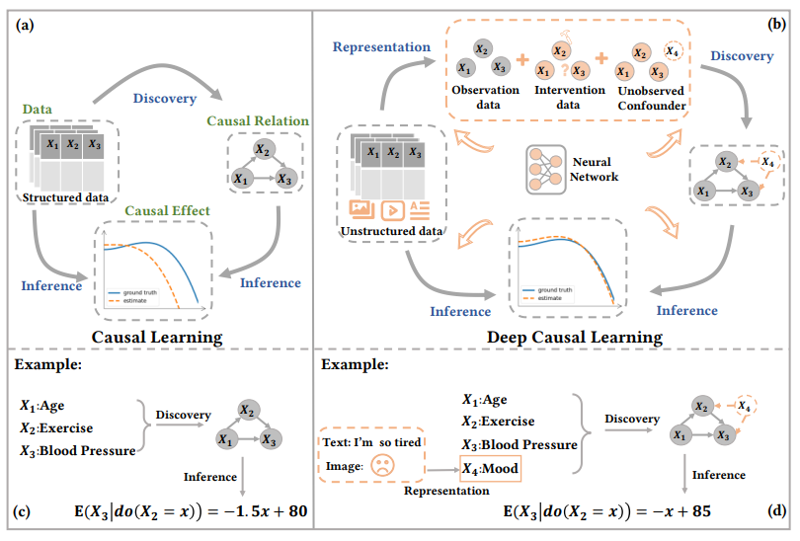
Introduction

Slide 27
02
Preliminaries
2.1 Structural Causal model
2.2 Potential outcome model
2.3 NN’s for causal learning

Slide 28

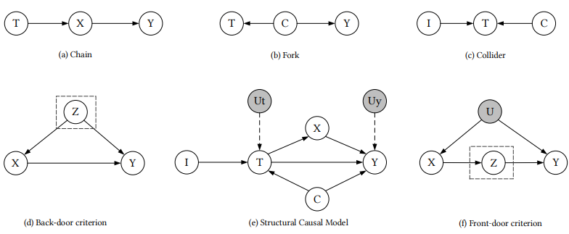
Structure Causal Model
Definition:
V : a set of endogenous(內生) variables
U : a set of set of exogenous(外生) variables
F : set of mapping functions accomplish the mapping from the parent node Pa_v to V.
P(u) : distribution of exogenous variables.
Causal Graph: directed acyclic graph (DAG)
X: covariates, Y: outcome, T:treatment, C: confounders, I: instrumental variable
U_t : exogenous variable of T, U_i: exogenous variable of Y
Data form:
observation data: passive collection without any intervention
intervention data: changing the value or distribution of a few variables, calculate average treatment effect (ATE)
counterfactual data:
individual treatment effects (ITE) can be calculated with the help of counterfactual theory

Slide 29
Structure Causal Model
Causal inference
Back-door adjustment
Front-door adjustment
Causal Discovery:
Constraint-based methods: 通過分析數據中的條件獨立性來推斷因果圖。ex: PC, FCI
Score-based methods: 網絡結構的某種形式的評分函數 ex: GES
Function-based method: 需要假設變量之間的數據生成機制，通過殘差的不對稱性來判斷因果方向。

Slide 30


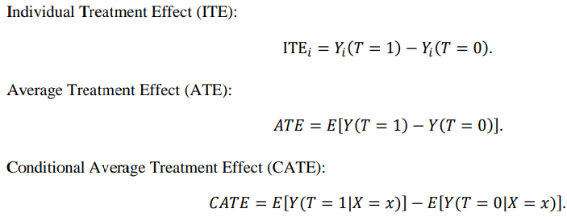
Potential Outcome model
Definition:
X: other covariates, Y: outcome, T: observed treatment, I: specific individual, N: nums of sample
Y(0) : potential outcome under no treatment, Y(1) : potential outcome under treatment
In the real world, we can only observe one of these outcomes, denoted as
Assumption:
Stable unit treatment value assumption
Unconfoundedness
Positivity

Slide 31
Potential Outcome model
Causal Inference:
Match: 匹配是從治療組和對照組中選擇個體，並不斷選擇最相似的兩個個體組成一對。Outcomes from matched samples can be approximated as counterfactual for each other
Propensity score matching:
Inverse of propensity weighting: reweighting.

Slide 32
Deep Neural Network
FMM(feed forward):
deep representation learning for causal variables
convert covariates from original space to latent space and
cooperate with regular terms to achieve covariate balance
GAN: generate counterfactuals to address the core problem of the lack of counterfactual data in causal inference, thus making it possible to estimate causal effects directly.
VAE: solve representation learning to disentangle causal mechanisms and estimation problems in the presence of unobserved confounders.
RNN: model sequential information and are used for causal discovery and causal inference problems in time series scenarios.
GNN: model relation information when individual relationships are network structures or to approximate structural causal models directly. The estimation of causal parameters and causal effects can be completed in the GNNs’ optimization process.

Slide 33
03
DEEP REPRESENTATION LEARNING FOR CAUSAL VARIABLES

Slide 34
Regularization Adjustment for Covariate Balance
Adjusted through various forms of regularization and attempts to balance covariates as much as possible, while obtaining structured variable representations
(1) obtain the representation of the original covariates
(2) predict the potential outcome
(3) core of the regularization adjustment-based representation learning framework, represents the difference in covariate distribution between the treatment and control groups. Study started from the perspective of covariate shift or domain adaptation to design this regular term.
(4) record the error between the predicted outcome Y_hat and the actual outcome Y
(5) optimizes prediction error and distribution error
the propensity scores can also be used to enable the representation network to learn balanced feat-

Slide 35
Regularization Adjustment for Covariate Balance
Dargon: in which the standard feedforward neural network is used to predict the probability of each sample receiving treatment and the representation is obtained from the hidden layer. Such representations do not contain treatment-independent variables and can be used to predict outcomes.
However, the balance of covariates helps to eliminate selection bias, but paying too much attention to the balance will affect the counterfactual prediction performance. While maintaining global balance
SITE: maintaining local similarity can help improve prediction accuracy. This method achieves global balance and local similarity and maintains certain predictive abilities while reducing selection bias.
Notes:
其中標準前饋神經網絡用於預測每個樣本接受處理的概率，並從隱藏層獲得表示。

Slide 36
Implicit Generation of Counterfactual Data
Implicit generation models do not directly model the probability density and likelihood functions [82]. Instead, they interact with training data to make the distribution of the data generated by the model close to the true distribution.
原因: 當 covariates 較多且關係特別複雜時，基於 weighting 或 balance 的方法往往效果不佳(由於covariates 之間的關係複雜，樣本數量有限，神經網絡得到的特徵表示不合理) 因此 implicit generation 以解決這個問題
和 regularization 不同的是， implicit generation 可以 it minimizes imbalance metrics。 基於 implicit generation 的 representation learning 消除了 selected bias，並且直接生成反事實數據，因為 dioscriminator 無法將接收到的樣本與處理組（T = 1）或控制組（T = 0）區分開來
GAN:
generator- sample from the noise directly,discriminator-learn the distance between the generated data distribution and real data distribution.

Slide 37
Implicit Generation of Counterfactual Data
GAN:
G: potential outcome generation, D: potential outcome discriminator.
G generates potential outcomes Y_hat based on covariates X, treatments Y and exogenous noise u
Improve the accuracy of subsequent causal effect estimation. 提高後續因果效應估計的準確性。
The adversarial learning architecture can be used to control for confounders in the latent space:
因為 G 生成的 data, D 分不出來。
multivariate treatment variables, continuous data, and time series

Slide 38
Explicit Generation for Disentangled Causal Mechanisms
在 explicit generation 的表徵學習中，每個 variable 都被認為是一種解開的因果機制以獲得更穩定的表徵
It assumes that a data generation mechanism can be decomposed into multiple independent causal mechanisms that are unrelated to each other and do not affect each other
one mechanism does not contain any information about the other
changes to one mechanic do not affect the other
VAE
X is the observed variable
G real mechanics generate factors
Z learned latent representation
IRS:proposes a new metric to measure the robustness of repr-
IM: automatically identify a set of independent mechanisms from the mixture of shifted data without labels
CFL: use of low-level data to discover high-level causal relations is proposed
Notes:
如果要求機器人抓取一個物體，它只需要知道物體的形狀和位置，而不是它的顏色。

Slide 39
04
DEEP CAUSAL DISCOVERY

Slide 40
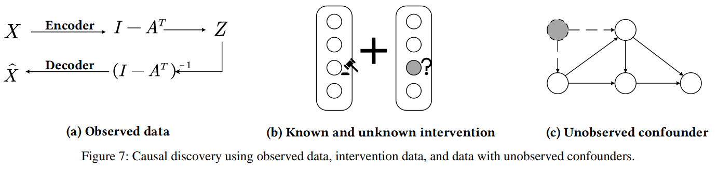
Observation Data-driven Causal Discovery
convert the constraints of acyclicity into constraints on the trace of the adjacency matrix
原因: 以前的 CD 都需要建立 DAG, 但因為資料量增加，所以變得太複雜。
A: the adjacency matrix of the causal graph
d : the number of nodes
ℎ(∙) : is a smooth function over real matrices
DAG-GAN: nonlinearities and encoder-decoder architecture,the adjacency matrix is obtained during the network training process to complete the structure selection
GAE utilizes the idea of graph self-encoder to better utilize graph structure information for causal graph structure discovery.
GraN-DAG: handle the parameter families of various conditional probability distributions
AEQ, CASTLE

Slide 41
Observation Data-driven Causal Discovery
Causal discovery in time series:
應用在 non-time series 的 CD 方法沒辦法用在 time-series 上，有幾個因訴必須考慮 ex: sampling frequency and unobserved confounders，並且需要有 necessary assumptions. Ex: cause must occur before the effect, there is no instantaneous causal effect.
Causal Graph:
full-time graphs: causal relationship between variables at each moment,
summary graphs: causal relationship during this time
Causal graph obtained from the time series is likely to have cycles, which does not satisfy the DAG condition.
Granger causal (GC) : 雖然GC在線性假設下可以達到常識性的結果，但是GC在非線性場景下的結果往往不盡如人意，因此發展出 GC-based 解決 non-linear 的方法
NGC: 將各個變量的函數表示分開，在一定程度上實現了因果的有效區分。
VCC: learns causality from sequential images combined with context
CCM: find causal relationships between time series variables in dynamical systems. It is especially suitable for nonlinear weakly coupled dynamical systems.
NSM:

Slide 42
Intervention Data-driven Causal Discovery
以前的大多數 CD 算法都已應用於 observed data； 將以前的方法直接應用於 intervention data 可能存在許多問題。 intervention data 揭示了有關數據生成 機制的更多信息，並使我們能夠獲得更準確的因果圖。
known intervention data
MTCD: meta-learning objective to measure the speed of adaptation
CBCD: utilizes VAE to extract binary conceptual causal variables from unstructured data that can explain the classifier
unknown intervention data
SDI: enables the simultaneous discovery of causal diagrams and structural equations in the presence of unknown interventions.
structural parameters, function parameters
CRN:(dynamic system): trains a learner to sample from different causal mechanisms each time. achieve domain adaptation to a certain extent and can also accumulate prior knowledge for subsequent structural learning.

Slide 43
Unobserved Confounders Data-driven Causal Discovery
原因: The unobserved confounders can lead to an observed association between two variables that do not have a causal relationship between them
CGNN: The most important contribution of this method is the formal definition of a functional causal model (FCM) with latent variables
SAM: It incorporates all variables other than itself into the equation
Instability: the randomness of the learning process or neural network initialization can influence their final performance and predictions even with the same data and parameters.

Slide 44
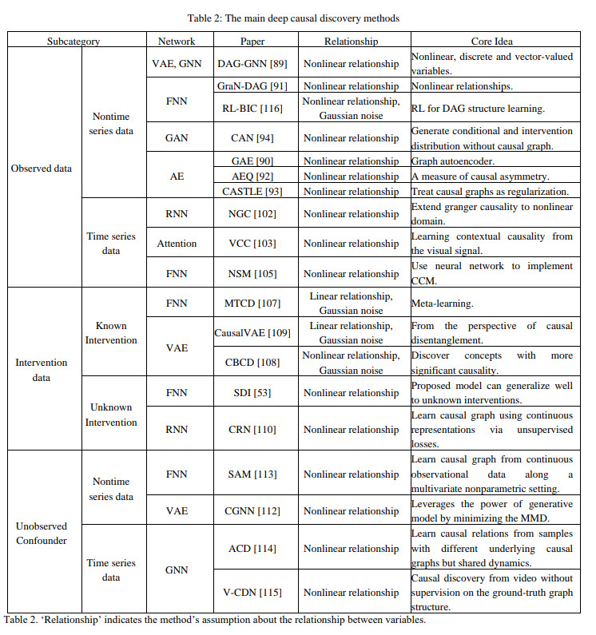
Unobserved Confounders Data-driven Causal Discovery
dealing with time series:
V-CDN: discover causal relations from video without ground truth by extracting key points from videos

Slide 45
05
DEEP CAUSAL INFERENCE

Slide 46
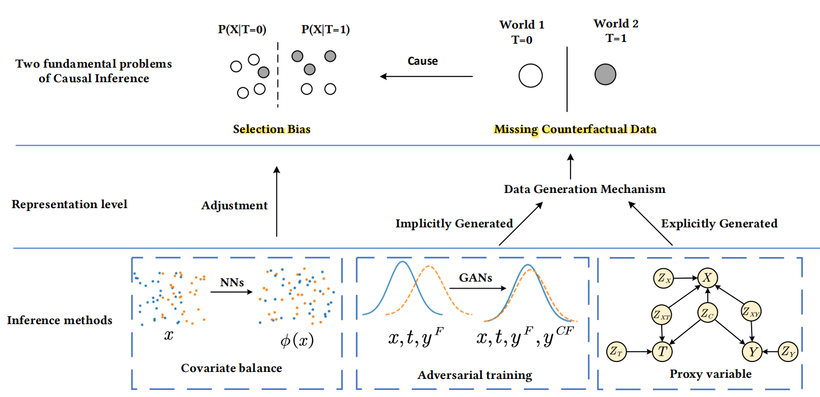
Introduction
Core problem:
(1) missing counterfactual data
(2)selection bias
CI method:
selection bias-oriented
Counterfactual data-oriented methods
Deep CI method to solve fundamental problem (1):
covariate balance-based methods: 調整 covariates 以平衡不同 treatment groups 中covariates 的分佈，從而消除選擇偏差(selection bias-oriented)
adversarial training-based methods: 利用對抗訓練使判別器無法區分真實數據和生成器生成的數據，從而實現隱式反事實數據的生成
proxy variable-based methods: 將數據生成機制建模為多個潛在變量之間的聯合作用，以實現顯式反事實生成
deep structural causal model methods: 通常將SCM和NN結合，利用SCM的結構信息和神NN的擬合能力對數據生成機制進行建模，實現反事實生成。

Slide 47
Causal Inference Through Covariate Balancing for (1)
因為 NN 的高fit能力，所以可以找到 T(treatment)和Y 之間的關係還有用 regular terms to balance the covariates X when used to estimate causal effects
NN: obtain the representations of covariates or the propensity scores(傾向得分) and then train estimators by minimizing the differences in representations between treatment and control groups; Loss fn: achieved through regularization terms; NN flexibly use various forms of regularization to balance the distribution of covariates to eliminate the influence of confounders. At the same time, it has a strong estimation ability and high accuracy.
BNN: achieve counterfactual predictions. 從領域適應的角度考慮反事實推理的問題。
CFR: two separate heads representing the control group and the treatment group, which share a representation network
PRG: was introduced to assess differences between the treatment and control groups.
PM: extends the approach to multiple treatment settings by using the balanced propensity score to make the match and estimating the counterfactual outcomes using the nearest neighbor
BWCRF: make a trade-off between balance and predictability. It is not a direct balance between groups, instead a weighted balance of representations.
Notes:
如果要求機器人抓取一個物體，它只需要知道物體的形狀和位置，而不是它的顏色。

Slide 48
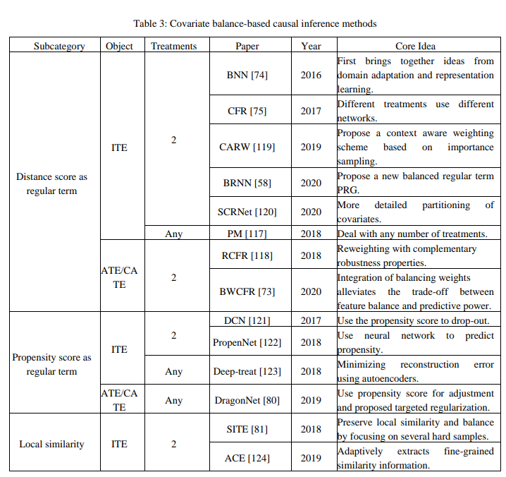
Causal Inference Through Covariate Balancing for (2)
Transforming the counterfactual problem into a domain adaptation problem 將反事實問題轉化為領域適應問題。
CARW: context-aware weighting scheme that leverages the importance sampling technique based on [75] to better solve the selection bias is integrated.
SITE: balanced representation learning method that preserves local similarity.
Covariates:
instrumental variables
adjustment variables
irrelevant variables
confounders

Slide 49
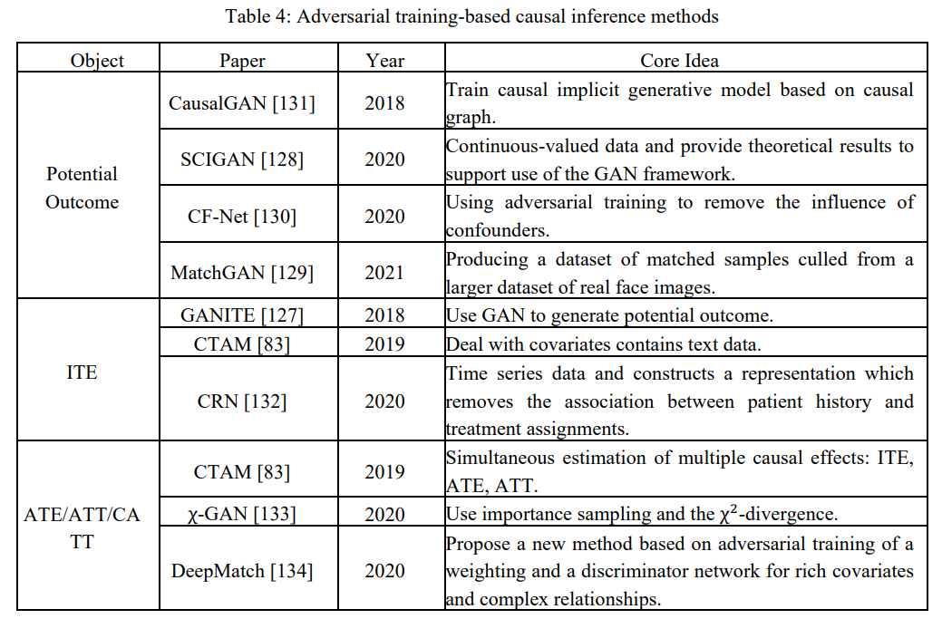
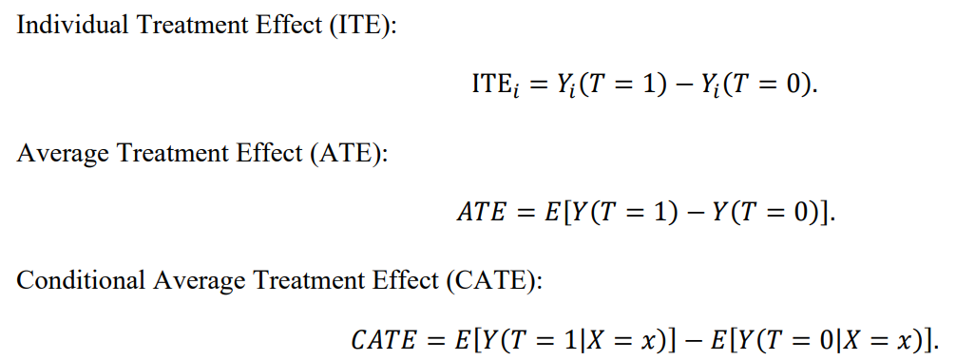
Adversarial Training for Causal Inference
GANITE: generate the counterfactual outcomes for a given set of covariates. It can deal with multiple treatment situations, At the same time, although there are multiple treatment variables to choose from, only one of them can be selected to match the actual situation.
SCIGAN: provides a theoretical verification of causal estimation under the GAN framework

Slide 50
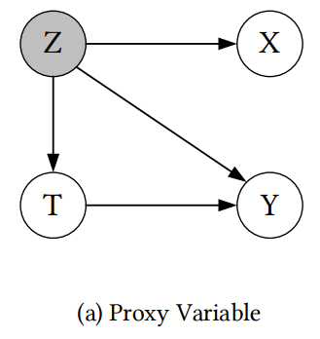
Proxy Variable-based Causal Inference
utilize proxy variables to separate different types of variables using disentangle representations.
how these proxy variables are used depends on their relationship to the unobserved confounders, treatments, and outcomes
CEVAE: uses latent variable generative models to discover unobserved confounders from the perspective of maximum likelihood.
The nonlinearity of the neural network is used to detect the nonlinearity of causal effects; that is, the neural network is used to fit the causal relationship between the variables
variational inference to obtain the probability distribution needed to estimate causal effects
it can cope well with the presence of unobserved confounders, but the disadvantage is the lack of theoretical guarantees
TEDVAE: use variational inference to infer latent variables from observed data and decouples them into these three types of variables
can also be used for continuous treatment variables.

Slide 51
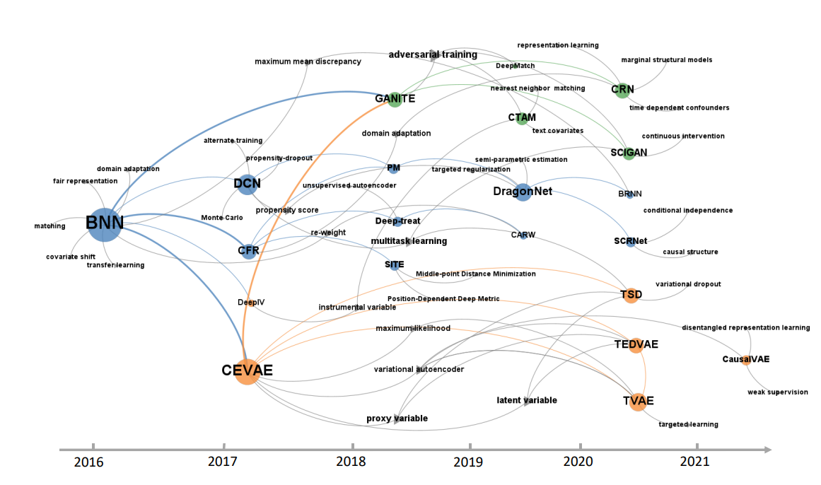
timeline of the main deep causal inference methods according to covariate balance-based, adversarial training-based and proxy variable-based methods.
covariate balance-based methods are the core of deep causal inference methods; adversarial training-based and proxy variable-based methods have received increasing attention in recent years.

Slide 52
Deep Structural Causal Model
deep fusion of neural networks and structural causal models resulted in a new model called the deep structural causal model.
They usually include a general approximation of neural networks and can model intervention distributions and counterfactual distributions.
GNN-SCM:
GNN: nonparametric function approximators for structural information.
SCM: realistic model for data generation
intervention is not necessary to identify causal effects
To build a deep structural causal model, the ability to model a distribution with three levels is required: association, intervention, and counterfactual
Three types of deep mechanisms combined with SCM have been discussed: explicit likelihood, amortized explicit likelihood, and amortized implicit likelihood.

Slide 53
End

